Slide 1
Graphics in DEXPI 1.4 Manfred Theißen, pnb plants & bytes

Slide 2
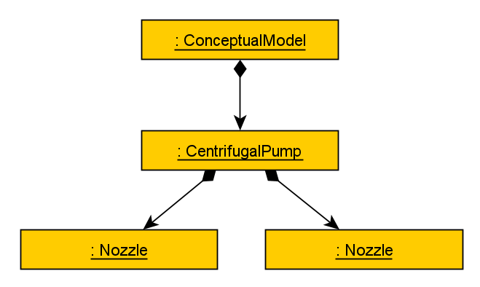
Example
P123

Slide 3
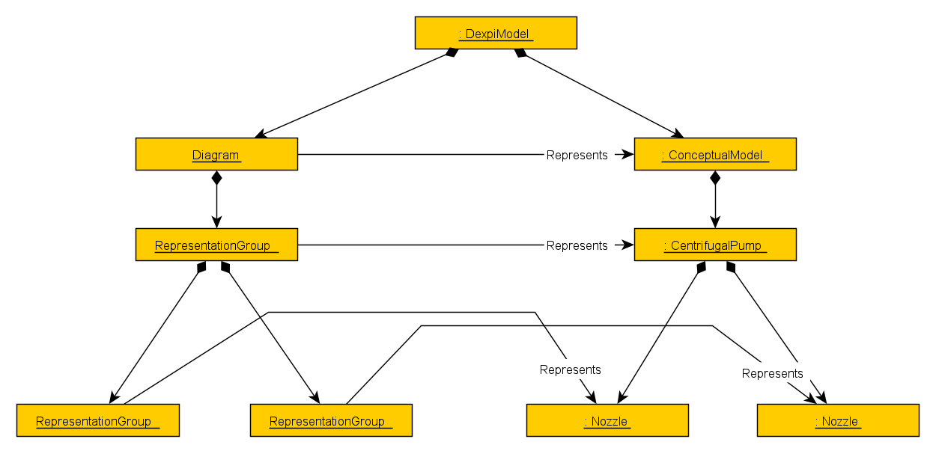
Example
P123
P123

Slide 4
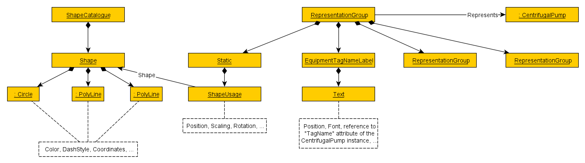
Example
P123
P123
P123

Slide 5
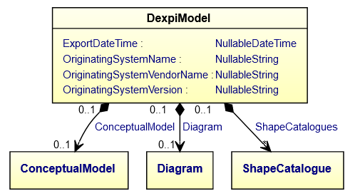
Graphics is part of future DEXPI Information Model 1.4 (details to be approved by content team, see https://dexpi.plants-and-bytes.de/1.4%20alpha%201/reference/Graphics/index.html for current state)
Same UML principles as in Conceptual Model classes, properties, associations, …, cf. table with UML concepts
Graphics classes are “based on SVG principles” vertical axis oriented from top to bottom, rotation clockwise,
currently a formal description of the “unwritten DEXPI graphics rules” for graphics that have emerged in the past
formally independent from Proteus, but expressiveness/features reflect what is possible in Proteus
new model is
description of status quo
basis for graphics exchange using some other format than Proteus
basis for discussion on required new features (e.g., line styles, “snapping” connector lines beyond pipes and signal conveying functions, …)

